Slide 1
Ethereum and Smart contracts
Pranay anchuri
Prepared for Wintersession – 2021, part ii

Slide 2
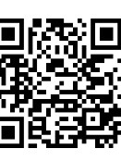
Logistics
Check-in :
http://cglink.me/c8741621021223726

Slide 3
Outline
Recap
Ethereum
Ether
Applications
Demo

Slide 4
Outline
Recap

Slide 5
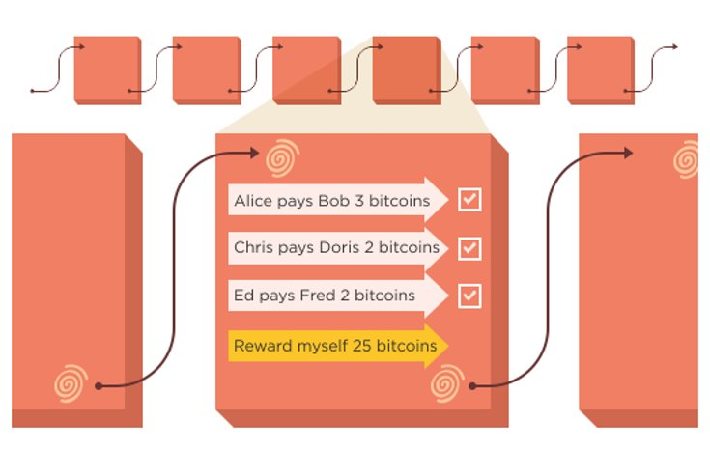
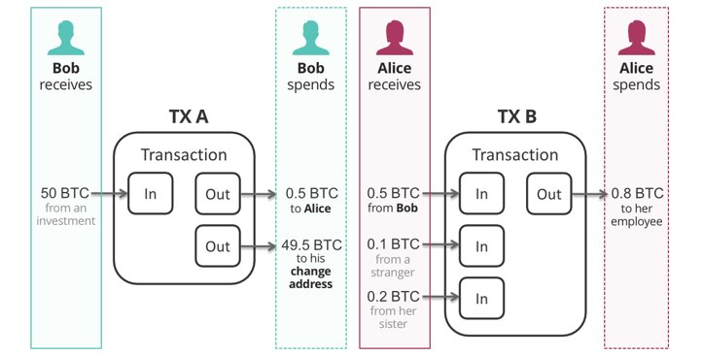
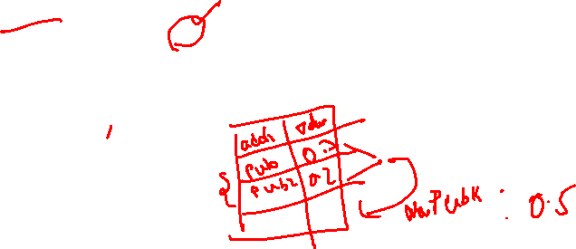
Bitcoin transaction and Blockchain

Slide 6
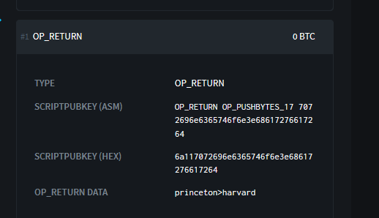
Applications of Bitcoin
Colored coins
Eternal wall
Eternal wall message

Slide 7
Outline
Recap
Ethereum

Slide 8
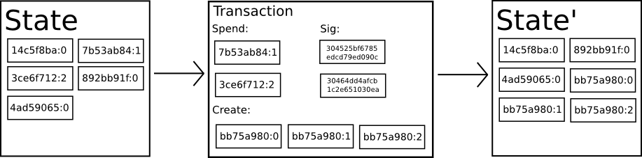
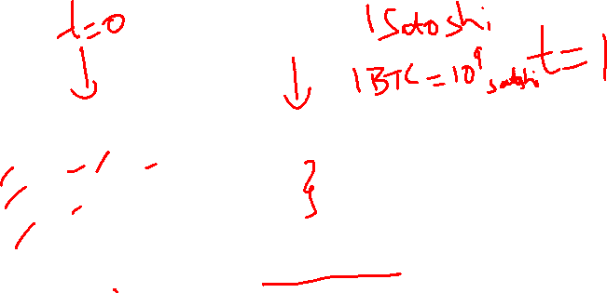
Bitcoin state transition
State of Bitcoin is the set of all outstanding coins
Each transaction consumes few coins and produce new coins
Transaction is essentially a state transition function
Mining rewards is a special case none of the existing coins are destroyed

Slide 9
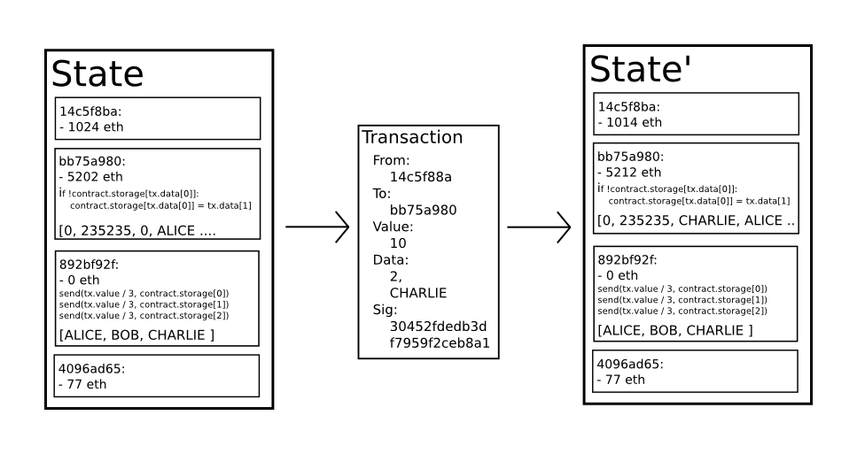
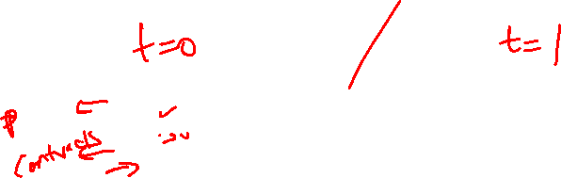
Ethereum state transition
Ethereum is a generalized version of Bitcoin with accounts, storage and complex logic to modify the storage.
A global computer that anyone can use, truly interact with other users and applications

Slide 10
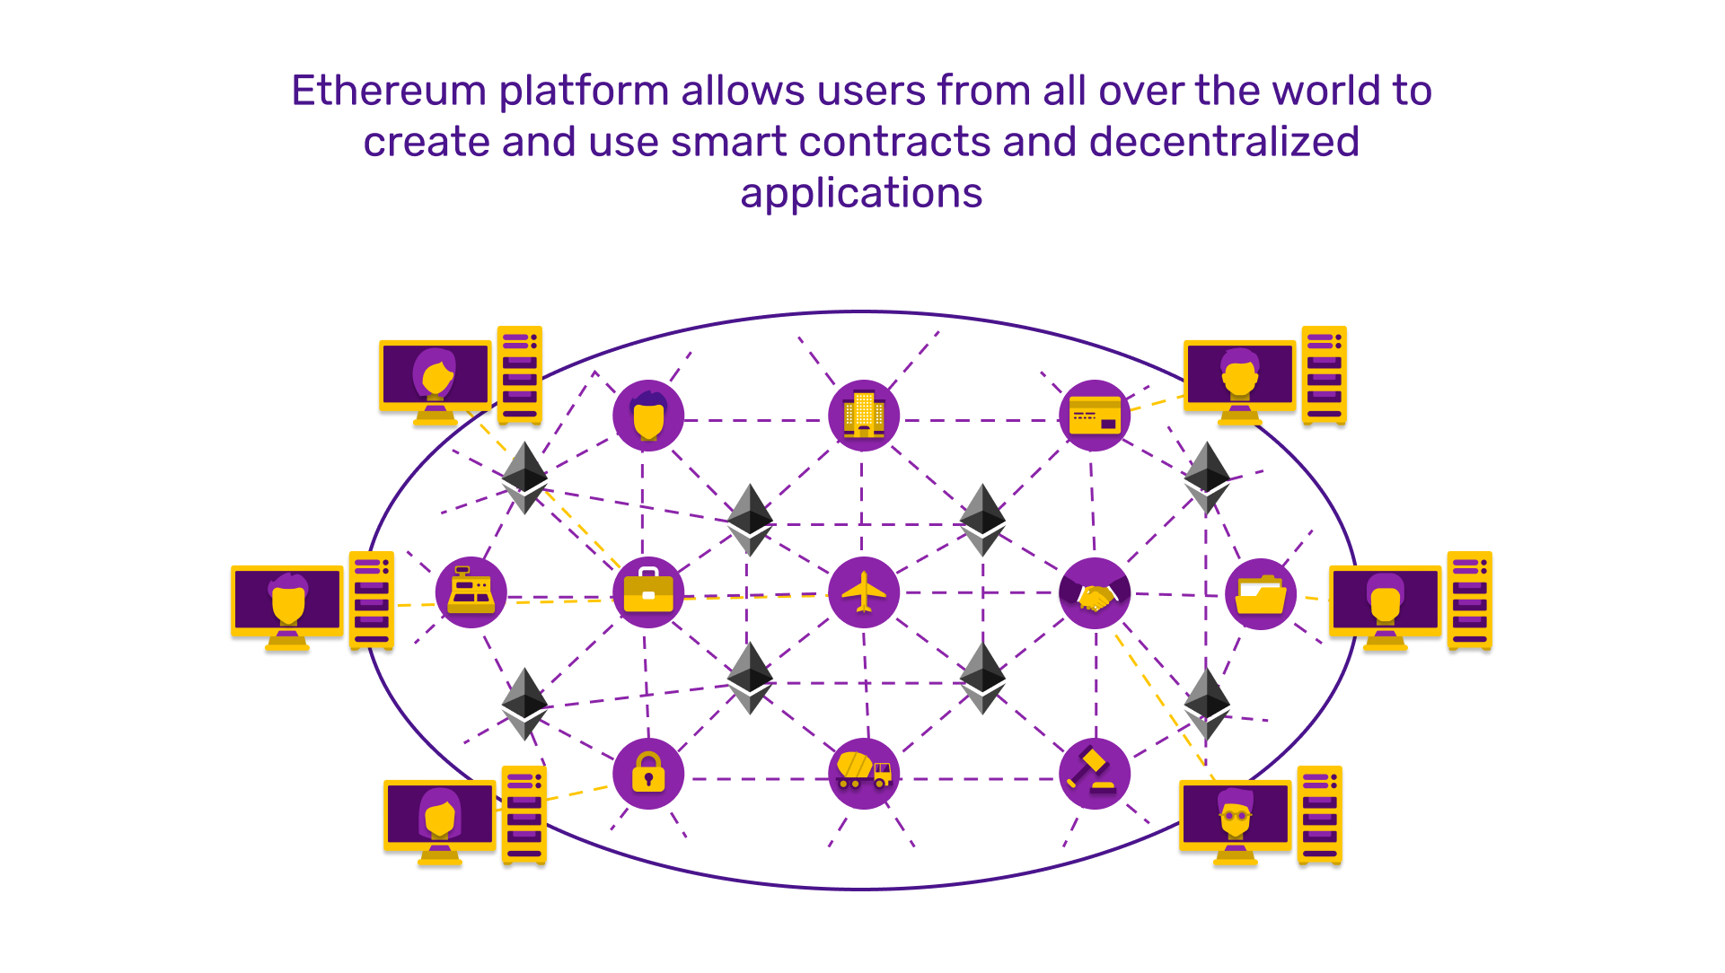
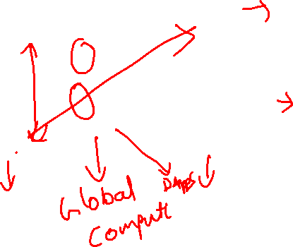
Ethereum world computer
A blockchain based generalized state transition mechanism enables a world computer
Decentralized apps (Dapps) like applications on desktop computer
Transactions are like user interactions
Ethereum is a synchronized, open for all computer that runs forever
Everyone runs a local copy of this synchronized machine
Massive replication

Slide 11
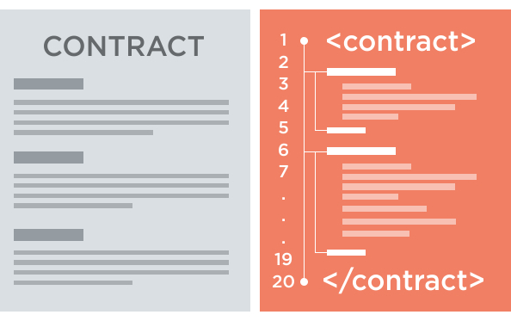
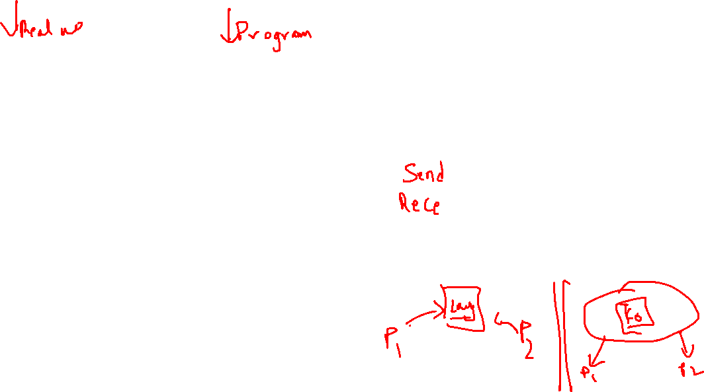
Smart contracts
Smart contracts are applications that are stored on world computer
Encodes logic that can modify state of storage via user interaction / transactions
Reduces the need for intermediaries in person-to-person interactions
Example : Rules for auction can be encoded in smart contracts
Anyone can deploy new smart contracts

Slide 12
Outline
Recap
Ethereum
Ether

Slide 13
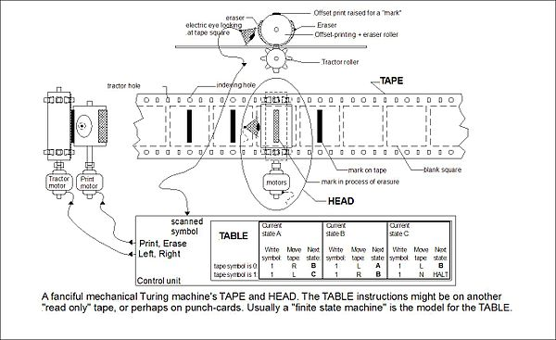
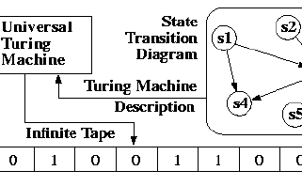
Turing machines
Turing machine is mathematical equivalent of a computer program
Consists of a finite state machine and an infinite tape
Current state and head of tape determines next state
Universal Turing Machine (UTM) can simulate other machines given their description
Every algorithm can be expressed as a Turing machine
UTM can run all algorithms

Slide 14
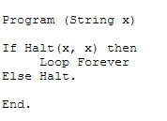
Halting problem
Undecidable problems are those which can't be answered yes/no
Halting problem :
Given an algorithm and an input return YES if the program terminates and NO otherwise
Halting problem is an example of undecidable problem
Undecidability of halting problem means that we can't algorithmically decide termination of all programs
Proof by contradiction

Slide 15
Turing machines and smart contracts
We want smart contracts that can represent complex logic and calculations, a Turing machine
Undecidability of halting problem poses a major challenge
We don't know in advance whether a given smart contract and input loops forever
In a personal computer, we could restart the machine

Slide 16
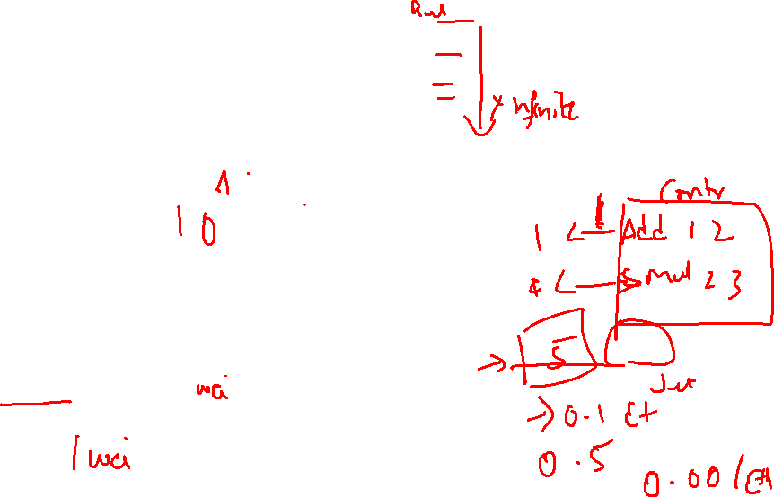
Halting problem in Ethereum
Ethereum’s “solution” for halting problem
Transaction initiator pays (in Ether) for every step of execution
Limited supply of Ether implies infinite loops can't execute
Every computation is expressed in Gas
Addition is 1 unit, multiplication is 4 etc
Gas price is not constant
Transaction cost = Total gas * Gas price (Pay what you wish model)
Easy to estimate approximately based on operations involved
1 Ether = 10^18 Wei

Slide 17
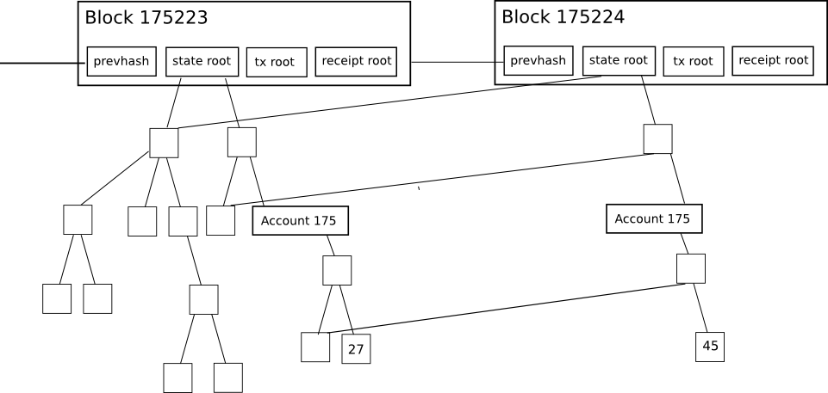
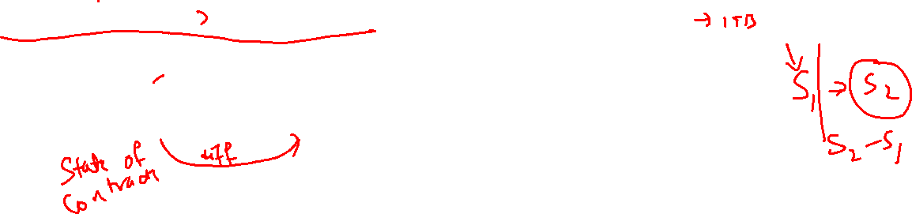
Merkle Patricia Tree
Storing the entire state is not feasible for everyone
Ethereum state is around 100s of GB
Nodes maybe interested in only updates to their accounts
Merkle Patricia Tree is a data structure for organizing the state as tree
Hash of the tree changes is included in every block

Slide 18
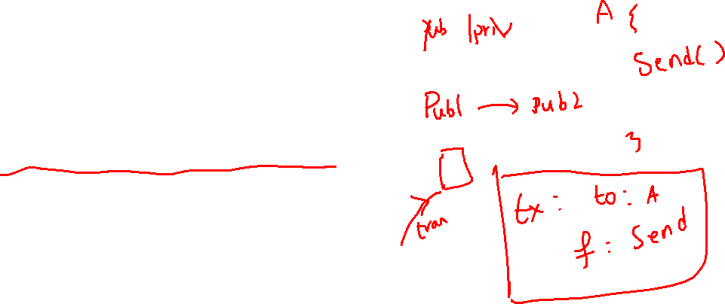
Accounts on Ethereum blockchain
Externally Owned Accounts (EOA)
Can be created independently, similar to bitcoin accounts
Private and public key
Can hold Ether tokens
Contracts
Can hold Ether
Can only be triggered in response to a transaction
Can deploy new contracts

Slide 19
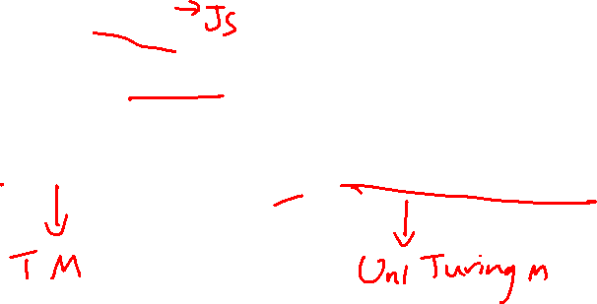
Ethereum Virtual Machine
Smart contracts are usually written in a specialized high-level language called Solidity
Smart contracts are compiled into machine interpretable instructions called bytecode
Bytecode (not the source code) is stored on blockchain
Bytecode instructions are executed on Ethereum Virtual Machine (EVM)

Slide 20
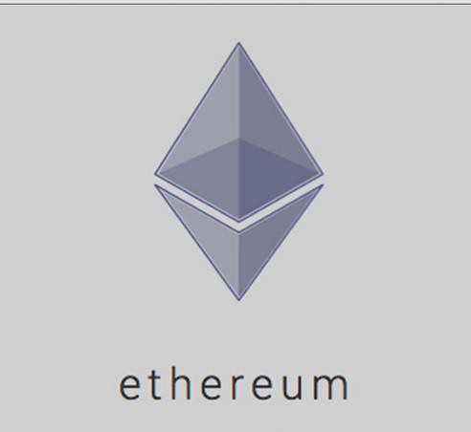

Putting it all together
Ethereum is a generalization of Bitcoin blockchain
Turing complete language to write arbitrarily complex smart contracts - Solidity
Uses proof-of-work model for ordering transactions
Miners execute transaction, update their blockchain state
Users set gas limit and gas price
State synchronization via matching root hash

Slide 21
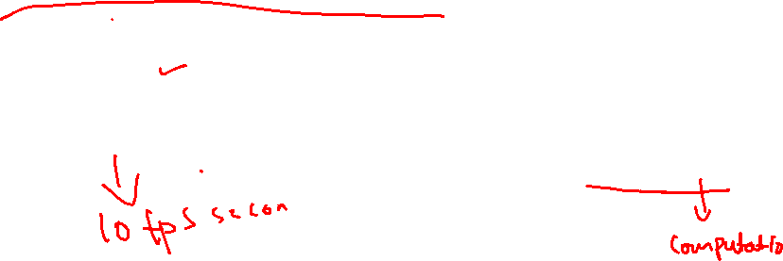
Bitcoin vs Ethereum
Bitcoin
Inflationary (21 million Bitcoins in total)
Primary use : Currency
Block time : ~ 10 minutes
Throughput : 1 MB blocks
Ethereum
Deflationary
Primary use : Platform for decentralized applications
Block time : ~13 seconds
Throughput : 21Million gas

Slide 22
Proof-of-stake
Ethereum blockchain consensus started with proof-of-work
Transition to proof-of-stake
Energy savings
“Stakers” deposit Ether for the ability to propose blocks
Block rewards
Interest

Slide 23
Outline
Recap
Ethereum
Ether
Applications

Slide 24
Decentralized Finance (DeFi)
DeFi : A peer-to-peer financial system, which leverages blockchain infrastructure to ensure integrity and security
Lending – Provides loans without no intermediaries
Decentralized exchange of tokens – Bancor
Derivative markets - Synthetix

Slide 25

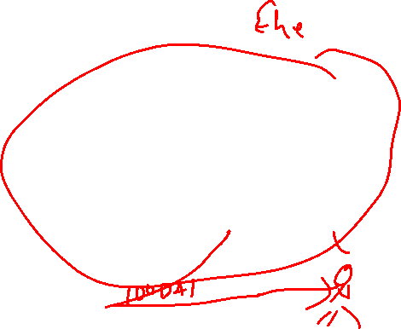
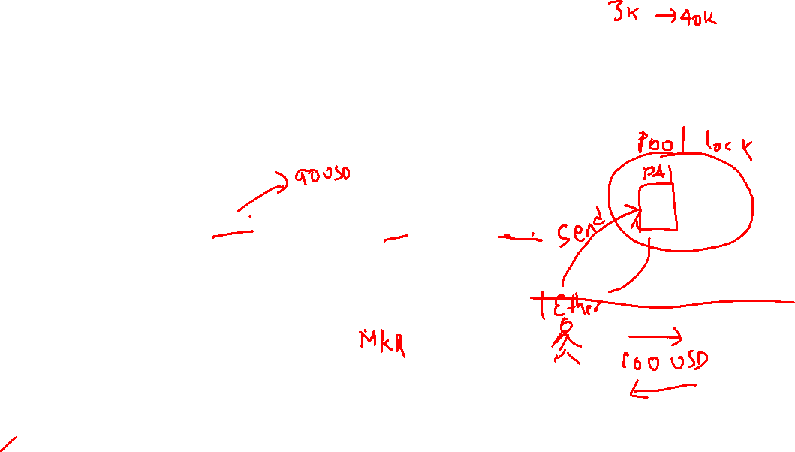
DAI – stable cryptocurrency
Bitcoin and Ether price against dollar is very volatile blocking their adoption in real-world
DAI is a stable coin built on Ethereum (as a smart contract)
Soft pegged to US dollar
1 DAI ~ 1 USD
DAI is created by over-collaterization on Ether
If price of 1 Ether is 150 USD, then locking up 1 Ether creates 100 DAI
Should lockup more Ether if price of Ether/USD falls
Position liquidated otherwise
All logic is encoded in a smart contract
Maker tokens for governance
Price supplied through decentralized oracles

Slide 26

Augur – Decentralized prediction market
Augur is a decentralized betting platform
Market can be created for any real-world event with a limited and deterministic set of outcomes
Anyone can create a market
Indicates possible outcomes
Reporting mechanism
Posts a deposit which is returned if the market resolves

Slide 27
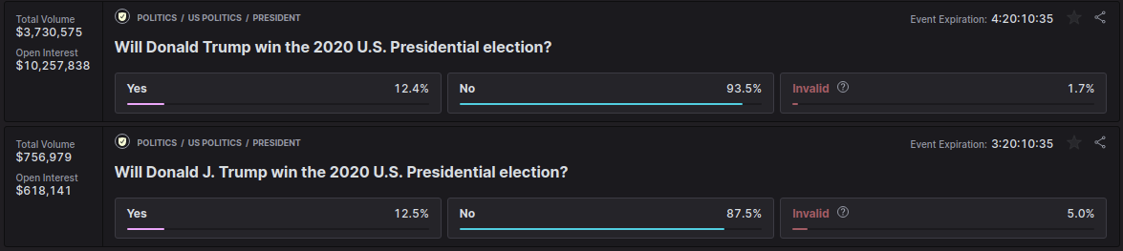
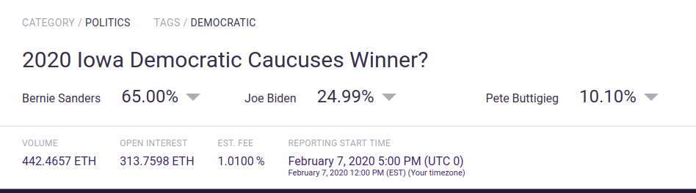
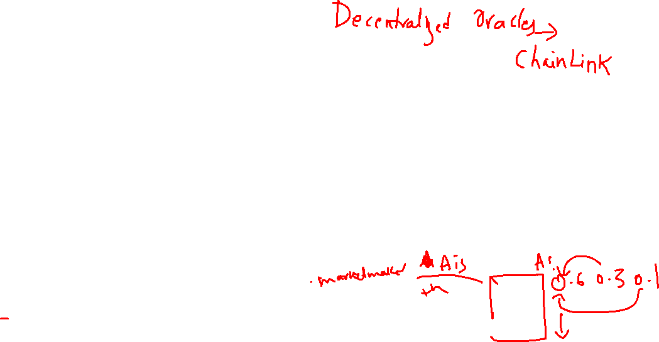
Augur - Trading
Shares of each outcome of market are traded via Ethereum blockchain
Order book for opening positions and matching buy/sell orders
Say a market has three outcomes A, B, C
I can place an order for 3 shares of A at 0.6 ETH per share
Matching finds open orders for B and C such that each share is exactly 1 ETH.
It can match B at 0.3 ETH and C at 0.1 ETH
At the end of event, the shares of winning outcome is 1 ETH and other shares are worthless
Ethereum is a closed system i.e., it only knows about Ethereum accounts and state
How to bring external facts ? Time, Stock prices, Weather etc

Slide 28
Outline
Recap
Ethereum
Ether
Applications
Demo

Slide 29
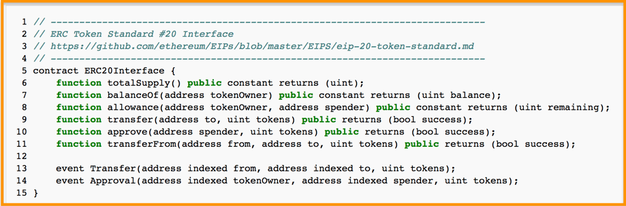
ERC-20 Smart Contract
Standardized smart contract for issuing, transfer of assets/coins
Ethereum blockchain provides
Cross-border transfer
Near instantaneous transfers
Traceability
Security
Coins can represent real-world or digital assets
In-game currency
Digital gold etc

Slide 30
Initial Coin Offering (ICO)
ICO is a means of fund-raising leveraging the decentralized security and validation offered by blockchain
Entrepreneurs receive capital (often in the form of cryptocurrencies) not for an equity stake but in exchange for a utility coin or token issued by the company
In traditional IPOs, investors receive equity stake (shares) in exchange for the capital (money)
Equities are tradable on an exchange (NYSE)
ICO tokens are tradable on centralized (Coinbase, Gemini) or decentralized exchanges (0x)
Types of ICO
Utility token : These are coins that can be redeemed later for goods or service
Security token offering : Like traditional securities and has regulatory oversight

Slide 31
Deploying a smart contract
Write smart contract in solidity
Requires minimal programming experience
Lots of tools
Compile
Bytecode
ABI
Test for bugs
Contract once deployed can’t be “upgraded”
Deploy the bytecode
Interact with the contract via new transactions

Slide 32
Deploy contract

Slide 33
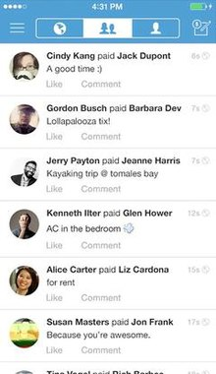
VenmoLite
Users pay each other Ether via contract
Contract may provide additional functionality like splitwise, request payments etc.
Payments are public
This Photo by Unknown author is licensed under CC BY-SA.

Slide 34
Swap PawPoints for Ether
Two smart contracts
PawPoints contract deployed by the University for issuing PawPoints on blockchain
Swap contract acts as decentralized marketplace for buying and selling miles
**Can be created by anyone!**
Four parties
A(PU) – deploys PawPoints contract and issues 10 points to B
C deploys swap contract
B places an order [H] 5 Points [W] 1 Ether and gives an allowance of 5 Points for contract C
D places an order [W] 5 Points [H] 1 Ether
Swap contract C matches Have and Want orders
Transfers points between B & D

Slide 35
Recap

Slide 36
Other aspects
Technical :
Scaling
Proof-of-stake
Layer-2 solutions
Adoption and societal impact
Privacy and legal

Slide 37
Announcements
Feedback : https://forms.gle/r4GfddDBtmkWmvwu6
Workshop materials :
Github : https://github.com/PranayAnchuri/wintersession-2021
Potential summer RA positions

Slide 38
Thank you ☺

